Slide 1


Strings
A String is a “collection of characters”.
  Ex. “chandigarh” , “chitkara”, etc..are strings
String is also defined as an ARRAY OF CHARACTERS or CHARACTER ARRAY which is terminated with a special character ‘\0’. “\0” is a null character
Ex> ‘H’, ‘O’ , ‘M’ , ‘E’ , ‘\0’ → is a string .
The string can be defined as the 1D array of characters terminated by a null ('\0')

Slide 2
Declaration of a strings:
i) Decleration as CHAR ARRAY:
Syntax:
char str[size]={ set of characters in ‘ ‘ };
  size is not mandatory.
  ii) Decleration as STRING LITERAL:
Syntax:
char str[size]=“set of characters in “;
Ex.
char str[] = {‘H', ‘O’ , ‘M', ‘E’, '\0'};
char str[5] = {‘H', ‘O’ , ‘M', ‘E’, '\0'};
  ex.
  char str[5] = “HOME";
  char str[] = “HOME";

Slide 3
Q)Write a C program to create a string using character array
  //character array
  #include<stdio.h>
  int main()
  {
  // declare and initialize string
  char str[5] = {'H','O','M','E','\0'};
  // print string
  printf("%s",str);
  return 0;
  }

Slide 4
Q)Write a C program to print your name using CHARACTER ARRAY.
  char str[ ] = {‘N',‘A',‘V','E', 'E', ‘N‘, '\0'};
  OUTPUT:
  Your Name is: NAVEEN

Slide 5
Q)Write a C program to print your name using character array.
  // PROGRAM TO PRINT YOUR NAME AS CHARACTER ARRAY
  #include<stdio.h>
  int main()
  {
  // declare and initialize string
  char name[ ]={'N','A','V','E','E','N','\0'};
  // print string
  printf("%s",name); //%s is used as format specified
  return 0;
  }

Slide 6
Compile time Initialization of string
Initialization of string as CHARACTER ARRAY
( character by character)
  Ex.
  char str[10] = {'H', 'e', 'l', 'l', 'o','\0'};
  -------------------------------------------------------------
  Program: Read display string at compile time as CHARACTER ARRAY.
  #include <stdio.h>
  #include<string.h>
  int main ()
  {
  char str[6] = {'H', 'e', 'l', 'l', 'o', '\0'};
  printf("str: %s\n", str);
  return 0;
  }
  ----------------------------------------------------------
  Note: NULL character ( \0 ) must be added manually in this case in the list of characters.
  →Initialization of string as a String literal i.e. All characters should be enclosed in between double quotes
  Ex: char str[10] = "Hello"; → a string literal
  -----------------------------------------------------------------------------
  Program: Read display string at compile time as STRING LITERAL
  #include <stdio.h>
  #include<string.h>
  int main ()
  {
  char city[ ] = “Chandigarh”;
  printf("str: %s\n", str);
  return 0;
  }
  ---------------------------------------------------------------------
  Note:NULL character ( \0 ) will be added at the end of the string automatically in this case

Slide 7
2.Runtime Initialization of string using scanf()
Reading a string using scanf()
Using scanf()
char str[ ];
scanf(“%s”,str); //reads entire stirng
%s → format specifier for string
char str[];
for(i=0;i<size;i++)
scanf(“%c”,&c[i]); //reads char by char
%c → format specifier for singe character
Program: Read display string at Runtime using scanf()
  #include <stdio.h>
  #include<string.h>
  Int main ()
  {
  char str[20] ;
  printf(“Enter string\n”);
  scanf(“%s”,str);
  printf("str: %s\n", str);
  return 0;
  }

Slide 8
Q)Write a C program to read your city name and display it .
  INPUT:
  Enter your city name:
  Chandigarh
  OUTPUT:
  Your city is… Chandigarh

Slide 9
Q)Write a C program to read your city name and display it .
  // PROGRAM TO PRINT YOUR CITY NAME and DISPLAY IT
  #include<stdio.h>
  int main()
  {
  char city[20];
  //read the string at runtime
  printf("Enter your city name\n");
  scanf("%s",city);
  // printint a string
  printf("Your city is ...%s",city); //%s is used as format specified
  return 0;
  }

Slide 10
2.Runtime Initialization of string using gets() function
Reading a string using gets()
Using gets()
-------------------------------------------------------------
Syntax
gets(stringname);
//Use <string.h> for gets() function
--------------------------------------------------------------
Ex.
char str[20] ;
gets(str); //no format specifier is required
puts(str) // display the string
Using gets()
gets(str);
Use <string.h> for gets() function
-------------------------------------------------------------------
Program: Read display string at Runtime using gets() and puts()
#include <stdio.h>
#include<string.h>
void main ()
{
char str[20] ;
printf(“Enter string\n”);
gets(str);
printf("string is\n”);
puts(str);
}

Slide 11
Q)Write a C program to read your first name and last name and display it .
  INPUT:
  Enter your first name and last name:
  Naveen Reddy
  OUTPUT:
  Your name is… Naveen Reddy

Slide 12
Q)Write a C program to read your first name and last name and display it .
  //program to read and print a string using gets() and puts()
  #include<stdio.h>
  #include<string.h>
  int main()
  {
  // declare and initialize string
  char name[25];
  //read characters of the string
  printf("Enter your first name and last name:");
  gets(name);
  // print string
  puts(name);
  return 0;
  }

Slide 13
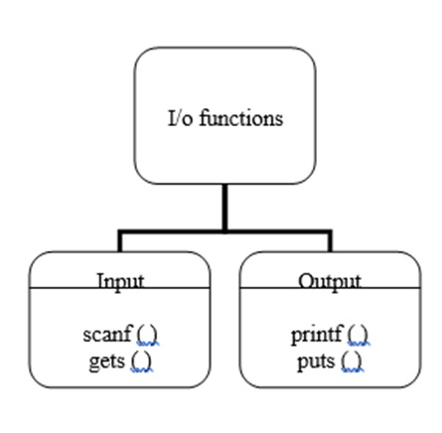
String I/0 functions
read→ Input Functions are: scanf(), gets()
display→ Output Functions are: printf(), puts()
gets() and puts() functions are available in <string.h>

Slide 14
String I/0→ input functions
i) Reading string using scanf() function:
It is a formatted input statement. It uses %s type specifier when reading string
  Syntax: scanf(“%s”, stringname);
  Ex1: char str[20];
  scanf(“%s”,str);
  Ex: char city[10];
  scanf(“%s”,city);
  → scanf() function, terminates reading its input on the first white space encounters.
  “Hello chandigarh” -→ it reads only Hello

Slide 15
String I/0→ input functions
ii) Reading string using gets() function:
The gets() function is used to read character string with white spaces.
ex. “Hello chandigarh” -→ it read “hello chandigarh”
Syntax:
gets(stringname); → %s is not required(unformatted)
  Ex1: char str[20];
  gets(str);
  Ex: char city[10];
  gets(city);

Slide 16
String I/O: Differences between scanf() and gets()
scanf() | gets()
reads all types of data. | Reads only string data.
It cannot read the white space between two words of a string. | It is used to read complete strings with white spaces.
It requires a format specifier to read formatted data. | It can read a single string at a time, It does not require a format specifier.
It is terminated by using white space. | It is terminated by entering the key or at end of the line.
Syntax: scanf(“list of format specifier”, list of addresses of variable); | Syntax: gets(String_variable);
char x[10],y[10]; scanf("%s%s",&x,&y); | char ch[10]; gets(ch);

Slide 17
Differences between scnaf() and gets()
// c program to read a string with scanf()
// c program to read a string with gets()
  #include <stdio.h>
  #include<string.h>
  int main()
  {
  char a[20];
  printf(“ener a string”);
  scanf(“%s”,a);
  printf(“output=%s”,a);
  return 0;
  }
  input: hello chitkara
  ouput: hello
  #include <stdio.h>
  #include<string.h>
  int main()
  {
  char a[20];
  printf(“ener a string”);
  gets(a);
  printf(“output=%s”,a);
  return 0;
  }
  input: hello chitkara
  Ouput: hello chitkara

Slide 18
Printing strings: i) using printf() ii) puts() functions
i) Printing string using printf() function:
It is a formatted output statement. It uses %s type specifier when printing a string
Syntax: printf(“%s”, stringname);
  Ex1: char str[20];
  printf(“%s”,str);
  Ex: char city[10];
  printf(“%s”,city);
  The printf() function is used to print both strings and variables of other type to the screen
ii) Printing string using puts() function:
It is used to display only string data and messages
It is an unformatted output statement. It does not uses %s type specifier when printing a string.
Syntax: puts( stringname);
  Ex1: char str[20];
  puts(str);
  Ex: char city[10];
  puts(city);

Slide 19
Differences between printf() and puts()
printf() | puts()
It is used to display all types of data and messages. | It is used to display only string data and messages.
It requires a format specifier to display formatted data. | It does not require a format specifier to display string.
It can display multiple data at a time by multiple format specifiers in one printf( ). | It is used to display only one string at a time.
Syntax: printf(“list of format specifier or message”, list of variables); | Syntax: puts(variable);
char x[10],y[10]; printf ("%s%s",x,y); | char ch[]="Hello"; puts(ch);

Slide 20
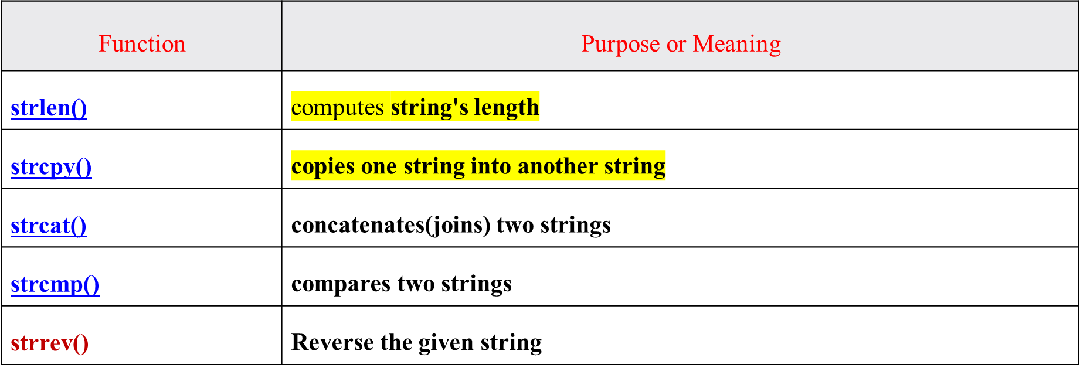
String Handling/Manipulation Functions
C supports a large number of string handling functions in the standard library "string.h".
Few commonly used string handling functions are discussed below:

Slide 21
String Handling/Manipulation Functions
1. strlen()-→ String Length
    It is used to find the length of the given string.
    It returns the length of the string.
    String length is the total number of characters in the string.
    NULL character will not included in the length of the string.
Syntax:
int len=strlen(stringname);
Example:
char str[10]=”Hello”; //10 size, length=5
int len;
len=strlen(str); // The value of len = 5

Slide 22
Write a c program tot find the length of string using strlen()
  INPUT:
  Enter string
  New Delhi
  OUTPUT:
  length of string is = 9

Slide 23
Program to find the length of string using strlen()
  //Program to find the length of string using strlen()
  #include <stdio.h>
  #include<string.h>
  int main ()
  {
  char str[20] ;
  int len;
  printf(“Enter string\n”);
  gets(str);
  len=strlen(str);
  printf("length of string is = %d\n”,len);
  return 0;
  }
  Output:
  Enter string
  New Delhi
  length of string is = 9

Slide 24
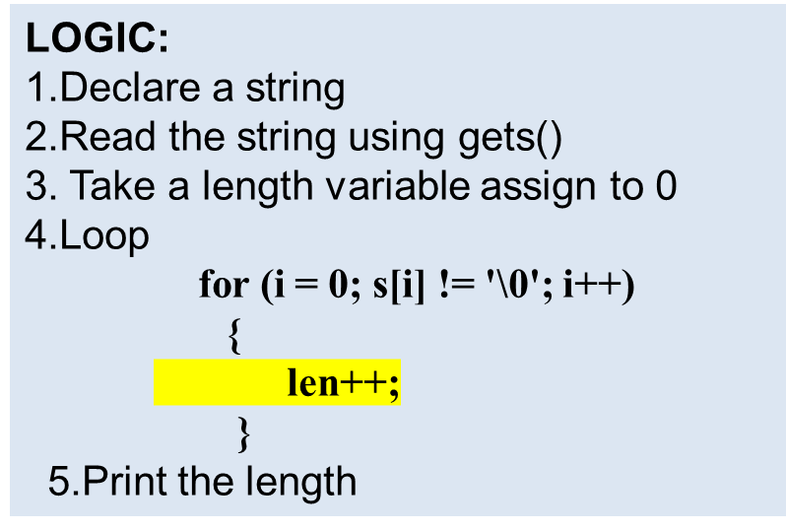
Write a C program to find the length of the string without strlen()
INPUT
Enter string
New Delhi
OUTPUT:
length of string is = 9

Slide 25
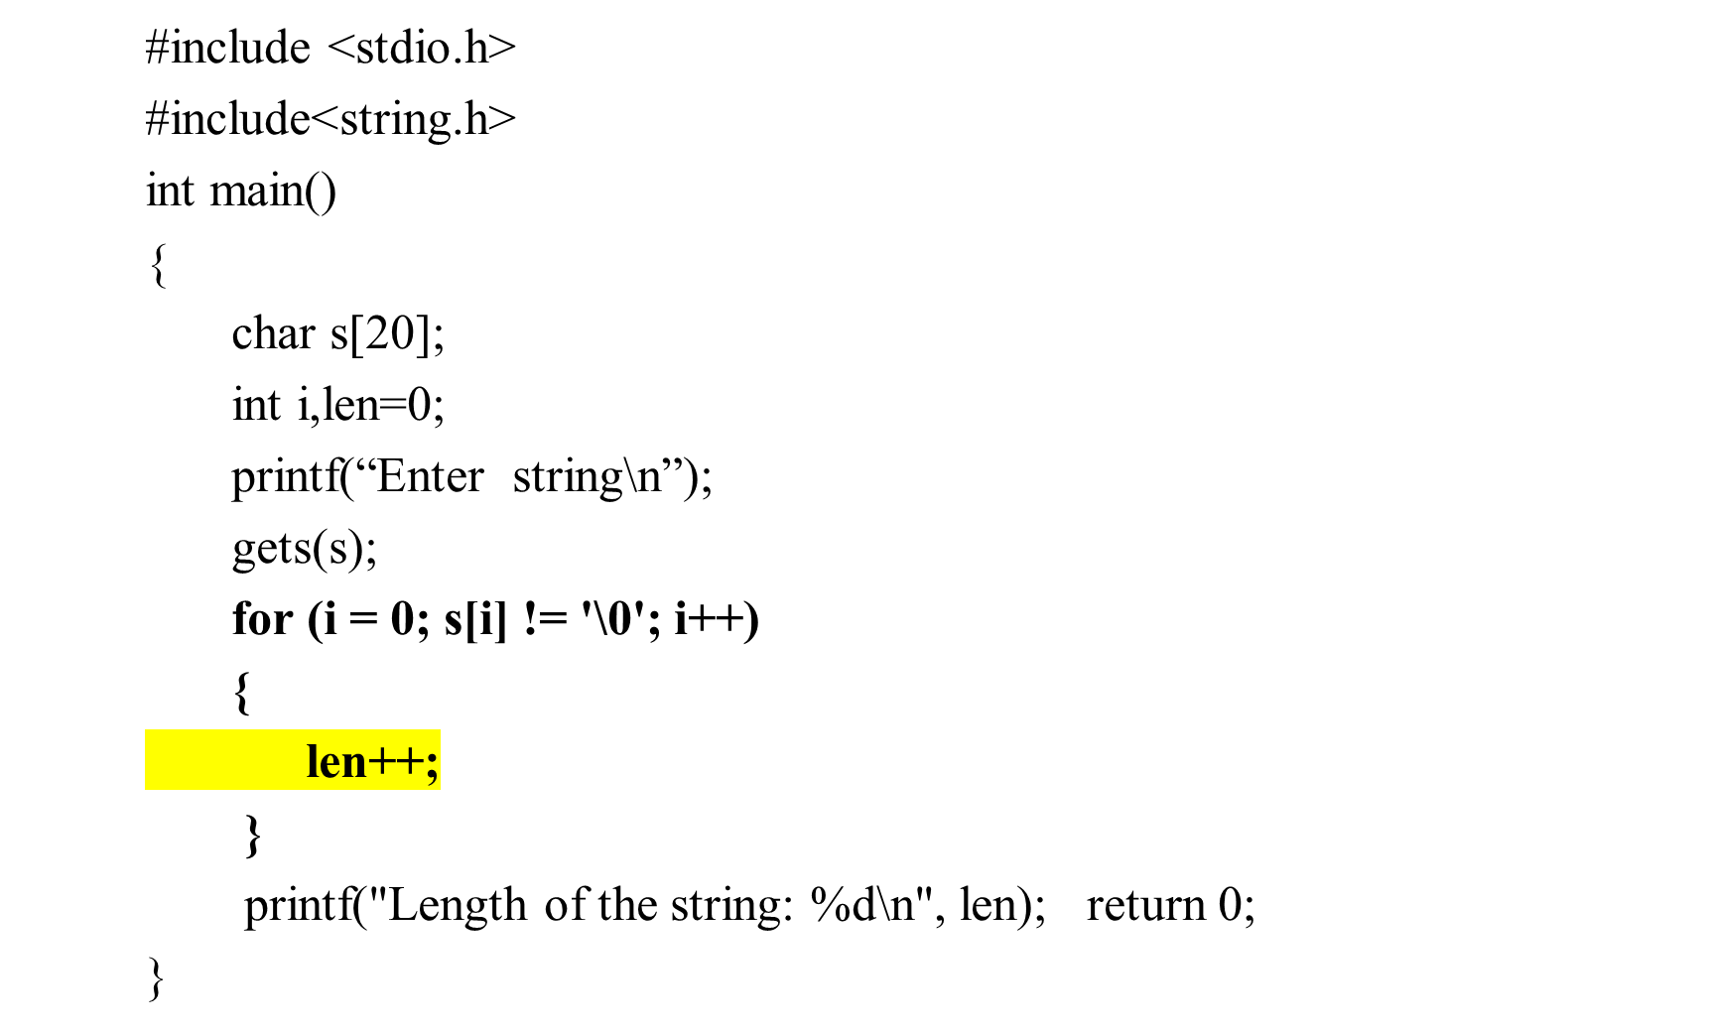
Write a C program to display the length of the string without strlen()
Output:
Enter string
New Delhi
length of string is = 9

Slide 26
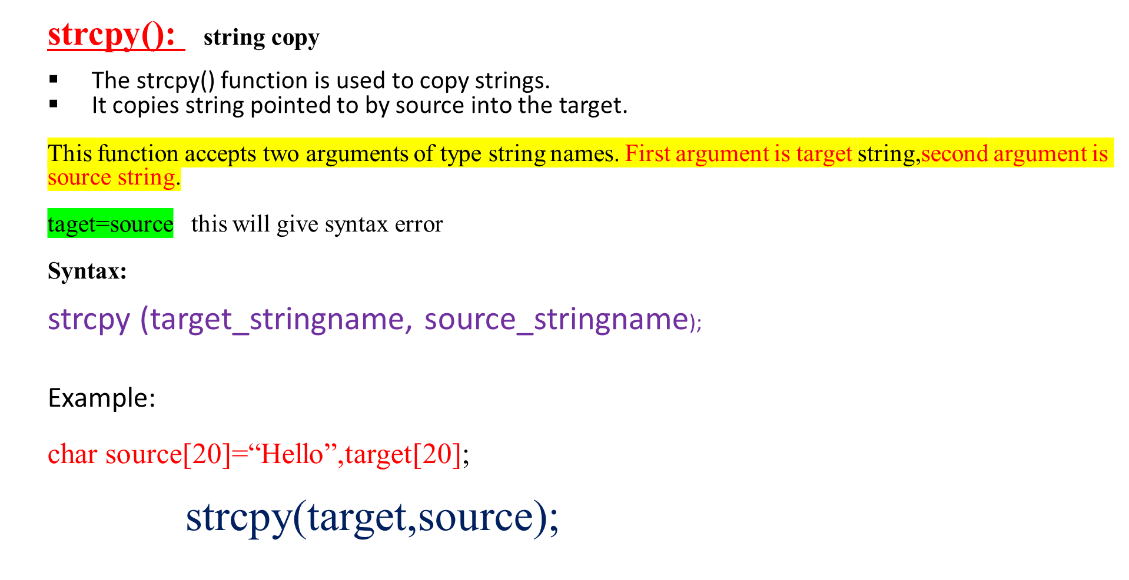
String Handling/Manipulation Functions

Slide 27
Program: To copy one string into another string using strcpy()
INPUT
Enter source string
Hello
OUTPUT:
Target string is
Hello

Slide 28
Program to copy one string into another string using strcpy()
//Program to copy one string into another string using strcpy()
#include <stdio.h>
#include<string.h>
void main ()
{
char souce[20],target[20] ;
printf(“Enter source string\n”);
gets(source);
strcpy(target,source);
printf("Target string is \n”);
puts(target);
}
Output:
Enter source string
Hello
Target string is
Hello

Slide 29
Write a c program to copy one string into another string without strcpy()
Output:
Enter Source string s1
Hello
Target string s2
Hello

Slide 30
//Program to copy one string into another string without strcpy()
#include <stdio.h>
#include<string.h>
void main ()
{
char s1[20],s2[20] ;
int i;
printf(“Enter source string s1\n”);
gets(s1 );
for (i = 0; s1[i] != '\0'; i++)
{
s2[i] = s1[i];
}
s2[i] = '\0';
printf("Target String s2\n”);
puts(s2);
}
Output:
Enter Source string s1
Hello
Target string s2
Hello

Slide 31
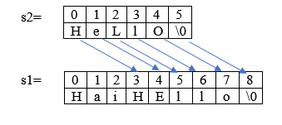
strcat(): string concatenation
strcat() concatenates (joins) or add two strings into one string.
It takes two arguments, i.e, two strings or character arrays, and stores the resultant concatenated string in the first string specified in the argument.
Syntax:
strcat(string1,string2);
string2 all characters will added at the end of string1.
Example: char s1[20]=”Hai”,s2[20]=”Hello”;
strcat(s1,s2);

Slide 32
Program to concatenate one string with another string using strcat()
Output:
Enter string1
Hai
Enter string2
Hello
Concatenated string is
HaiHello

Slide 33
Program to concatenate one string with another string using strcat()
  #include <stdio.h>
  #include<string.h>
  void main ()
  {
  char s1[20],s2[20] ;
  printf(“Enter string1\n”);
  gets(s1);
  printf(“Enter string2\n”);
  gets(s2);
  strcat(s1,s2);
  printf("Concatenated string is \n”);
  puts(s1);
  }
Output:
Enter string1
Hai
Enter string2
Hello
Concatenated string is
HaiHello

Slide 34
String Handling/Manipulation Functions
strcmp() : String comparison
It can be used to compare one string with another string. The strcmp() function takes two strings and returns an integer.
The strcmp() compares two strings char
If the first character of two strings is equal, the next character of two strings are compared. This continues until the corresponding characters of two strings are different or a null character '\0' is reached. acter by character.
Syntax:
int strcmp(string1,string2);
string1 of each character is compared with string2 of same index character.
Example: char s1[20]=”Hai”,s2[20]=”Hello”;
int k;
k= strcmp(s1,s2);

Slide 35
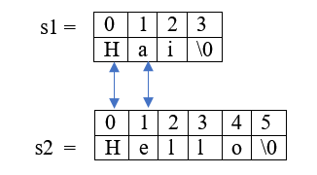
String Handling/Manipulation Functions
First it compares index 0 of both strings s1[0] ==s2[0](equal), then next compares index 1 of both strings , so s1[1]!=S2[1] so it returns difference of ASCII values of s1[1] and s2[1] i.E, a-e(97-101). So k=-4.
Return Value | marks
0 | if both strings are equal
Negative integer | if the ASCII value of the first unmatched character is less than second.
Positive integer | if the ASCII value of the first unmatched character is greater than second.

Slide 36
Write a C Program to Compare two strings using strcmp()
Output:
Enter string1
Hai
Enter string2
Hello
strings are not equal

Slide 37
Program to Compare two strings using strcmp()
#include <stdio.h>
#include<string.h>
void main ()
{
char s1[20],s2[20] ;
int k;
printf(“Enter string1\n”);
gets(s1);
printf(“Enter string2\n”);
gets(s2);
k=strcmp(s1,s2);
if(k==0)
printf("strings are equal \n”);
else
printf("strings are not equal \n”);
}
Output:
Enter string1
Hai
Enter string2
Hello
strings are not equal

Slide 38
strrev() : String reverse
strrev() : String reverse
  It reverses the given string.
  It takes only one argument i.e, stringname.
  Reverse string is stored in the same variable.
Syntax: strrev(stringname);
Example:
char str[20]=”Hai”;
strrev(str);
str = “iaH”

Slide 39
Write a C program reverse the given string using strrev()
INPUT
Enter string
Hello
OUTPUT
Reverse string is
olleH

Slide 40
Program reverse the given string using strrev()
#include <stdio.h>
#include<string.h>
void main ()
{
char str[20];
printf(“Enter string\n”);
gets(str);
strrev(str);
printf(“Reverse string is\n”);
puts(str);
}
Output:
Enter string
Hello
Reverse string is
olleH

Slide 41
Write a C program to copy one string into another string without strcpy()
INPUT
Enter Source string s1
Hello
OUTPUT
Target string s2
Hello

Slide 42
Write a C program to copy one string into another string without strcpy()
#include <stdio.h>
#include<string.h>
void main ()
{
char s1[20],s2[20] ;
int i;
printf(“Enter source string s1\n”);
gets(s1 );
for (i = 0; s1[i] != '\0'; i++)
{
s2[i] = s1[i];
}
s2[i] = '\0';
printf("Target String s2\n”);
puts(s2);
}
Output:
Enter Source string s1
Hello
Target string s2
Hello

Slide 43
INPUT
Enter string1
Hai
Enter string2
Hello
OUTPUT:
Concatenated string s1 is
HaiHello

Slide 44
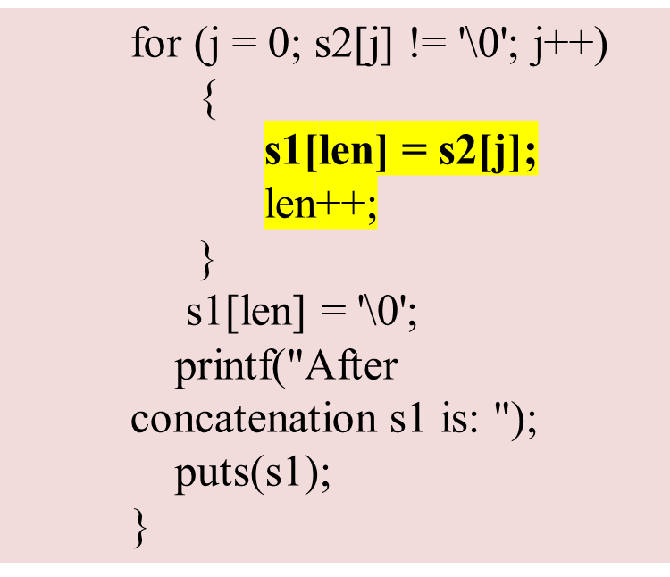
#include <stdio.h>
#include<string.h>
int main ()
{
char s1[20],s2[20] ;
int i,j,len=0;
printf(“Enter string1\n”);
gets(s1);
printf(“Enter string2\n”);
gets(s2);
for (i = 0; s1[i] != '\0'; i++)
{
len++;
}

Slide 45
Write a C program to reverse the string without strrev()
INPUT
Enter string
Hello
OUTPUT
Reverse string is
olleH

Slide 46
Write a C program to reverse the string without strrev()
#include<stdio.h>
#include<string.h>
int main()
{
char str[100], temp;
int i,j;
printf("\nEnter the string :");
gets(str);
j = strlen(str) - 1; //j=5-1=4
for(i=0;i<j;i++)
{
temp = str[i];
str[i] = str[j];
str[j] = temp;
j--;
}
printf("\nReverse string is :%s", str);
return 0;
}

Slide 47
Write a program in C to count the total number of words in a string.
INPUT :
Input the string : Welcome to Chitkara
Expected Output :
Total number of words in the string is : 3

Slide 48
//Write a program in C to count the total number of words in a string.
#include <stdio.h>
#include <string.h>
#include <stdlib.h>
#define str_size 100 //Declare the maximum size of the string
int main()
{
char str[str_size];
int i, wrd;
printf("Input the string : ");
fgets(str, sizeof str, stdin);
i = 0;
wrd = 1;
while(str[i]!='\0')
{
/* check whether the current character
is white space or new line or tab character*/
if(str[i]==' ' || str[i]=='\n' || str[i]=='\t')
{
wrd++;
}
i++;
}
printf("Total number of words in the string is : %d\n", wrd-1);
return 0;
}

Slide 49
Write a C program to check whether the given string is palindrome or not
INPUT:
Enter the string: LIRIL
OUTPUT:
The riverse of a given string is : LIRIL
The given string is a polindrome

Slide 50
Program: String Paindrome
#include<stdio.h>
#include<string.h>
int main()
{
char s1[100],s2[100];
int i,j,len,k;
printf("\nEnter the string1 :");
gets(s1);
len=strlen(s1);
j=0;
for(i=len-1;i>=0;i--)
{
s2[j]=s1[i];
J++;
}
s2[j]=’\0’
printf("\nReverse string is :%s", s2);
k=strcmp(s1,s2)
if(k==0)
printf(“%s is palindrome\n”,s1);
else
printf(“%s is not palindrome\n”,s1)
return 0;
}

